Slide 1

Session 16 (of 24)
PGR112 Objektorientert programmering
Yuan Lin / yuan.lin@kristiania.no

Slide 2
Today’s Main Goal
OOP Repetition
A Step-by-Step go through of BankLoanSolution
Recipes for Clean Code

Slide 3
Today’s Main Goal
OOP Repetition

Slide 4
Object Oriented Programming
Object oriented programming is a methodology to design a program using classes and objects
Major OOP concepts we have learned
Class
Object
Inheritance
Polymorphism
Encapsulation
Abstraction
Other terms we have learned and used in OOP design
Aggregation
Low coupling & high cohesion
We have also learned
Exception handling, HashSet, HashMap, Optional, equals, hashCode, Lambda..

Slide 5
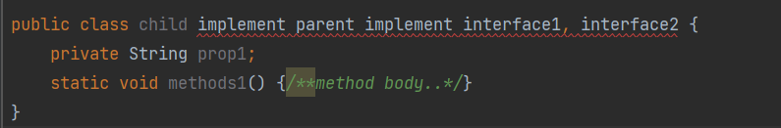
Class
A class is user defined prototype from which objects are created
It represents the set of properties or methods that are common to all objects of one type.
A class declaration can include
Modifiers: public, default access
Class name
Superclass: if any, preceded by keyword extends. In java, a class can only extend from one superclass. (Java does not support multi-inheritance)
Interfaces: if any, preceded by keyword implements. In java, a class can implement more than one interface. Multi-interfaces are comma-separated
Body: the class body is surrounded by {}
Example

Slide 6
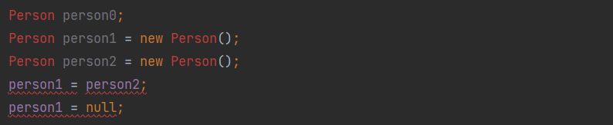
Object
An object can be defined as an instance of a class.
An object contains an address and takes up some space in memory.
A constructor call (new) returns a reference to an object. A reference is information about the location of object data.
Assigning a reference type variable copies the reference.
Object reference is stored in stack, while object stores in heap.
Setting an object to null makes the object unreachable and triggers garbage collection.
The object class is the parent class of all the classes in java by default.

Slide 7
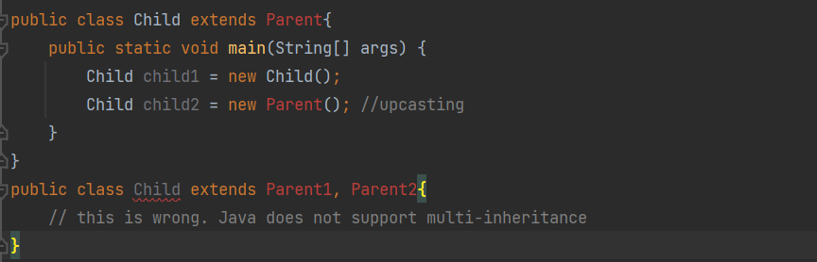
Inheritance
Inheritance allows one class to inherit the features (fields and methods) of another class.
Superclass (parent class) is the class who is inherited
Subclass (child class) is the class who inherits the other class
Java does not support multiple inheritance.
Inheritance achieves code reusability.
Inheritance is used to achieve runtime polymorphism.
During inheritance, only the object of subclass is created, not the superclass.

Slide 8
Polymorphism
In Java, polymorphism is mainly divided into two types:
Compile-time polymorphism
Runtime polymorphism
Compile-time polymorphism is achieved by function overloading
Functions are said to be overloaded if multiple functions are of the same name but different parameters (data type, number, order)
Functions are not said to be overloaded if only return type is different since JVM is not able to decide during compilation time.
Runtime polymorphism is achieved by function overriding
Function overriding occurs when a method in the parent class is overridden by the child class.
A function call to the overridden method is resolved at Runtime.
Use @Override is a nice coding practice.
Method hiding
When a subclass defines a static method with the same signature as a static method in the superclass.

Slide 9
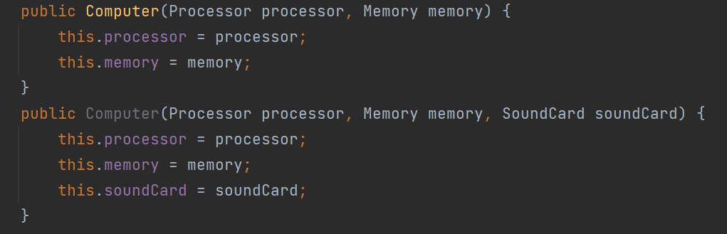
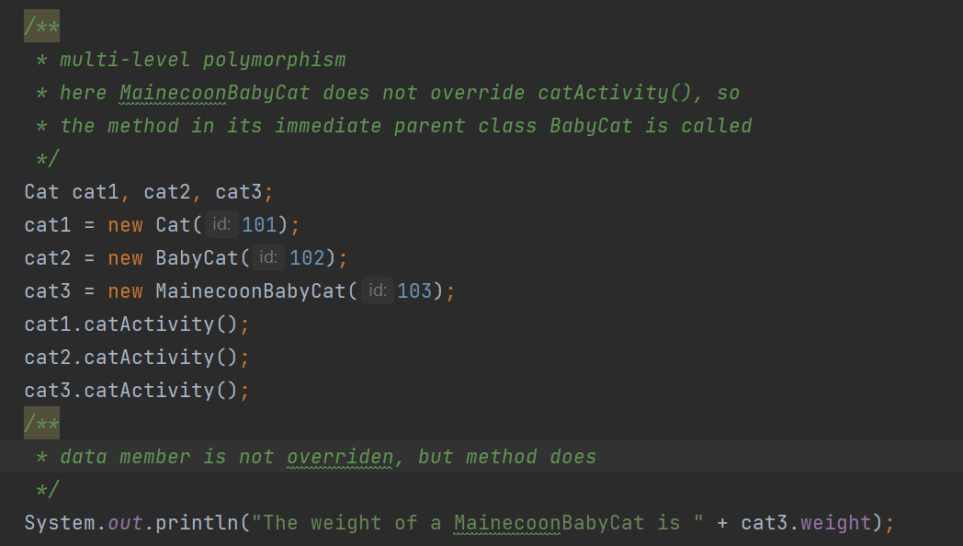
Polymorphism
Constructor overloading example – Function overloading
A upcasting example –function overriding

Slide 10
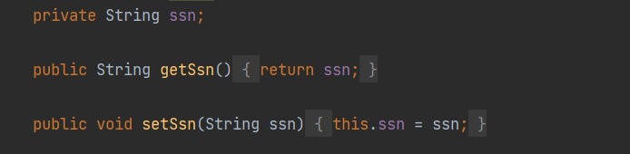
Encapsulation
A Java class is the example of encapsulation.
Technically in encapsulation, the variables of a class is hidden from any other class and can be accessed only through methods if its own class.
Encapsulation is achieved by Getters/Setters/Access modifiers
Declare all variables as private
Provide public Getters/Setters for access from outside of the class.
Advantages of encapsulation
Data hiding; Read-only or write-only access flexibility, Reusability; Easy testing

Slide 11
Abstraction
In Java, abstraction is achieved by interface and abstract classes.
Feature of abstract classes – keyword: extends
An abstract class is a class that is declared with an abstract keyword.
An abstract method is a method that is declared without implementation.
An abstract class can have both abstract and concrete methods (methods that have function body).
An abstract method must be overriden in the subclass, or either make the subclass abstract.
An abstract class can not be directly instantiated with new.
Features of interfaces – keyword: implements
Interfaces can only have abstract methods and variables.
If a class that implements an interface does not implement abstract methods, it must be declared as abstract.
A class can implement multiple interfaces.

Slide 12
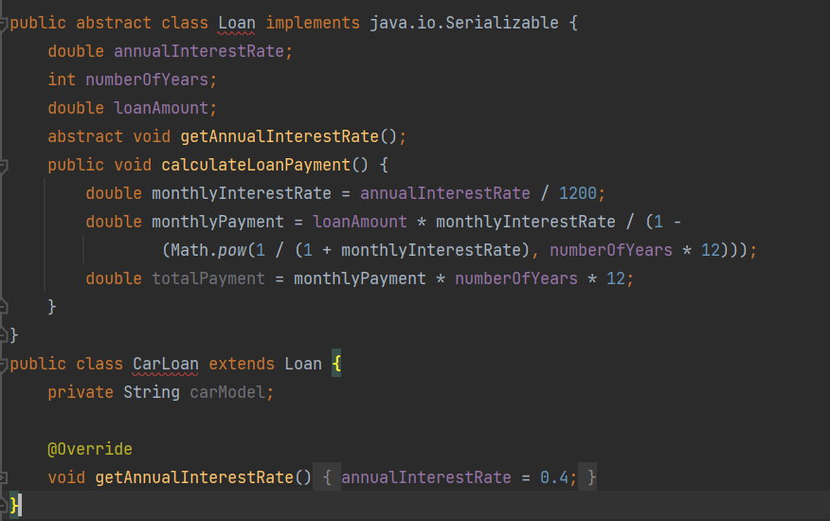
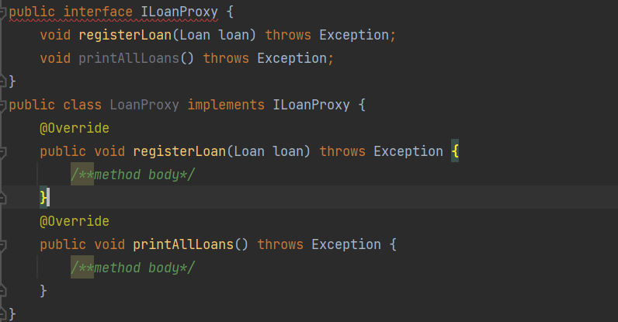
Abstraction
Abstract class example
The abstract class contains both abstract and concrete methods.
Class that extends abstract class must override the abstract method (or declare itself as abstract class)
Interface example
The interface contains only abstract methods.
Class that implements interface must override the abstract method (or declare itself as abstract class)

Slide 13
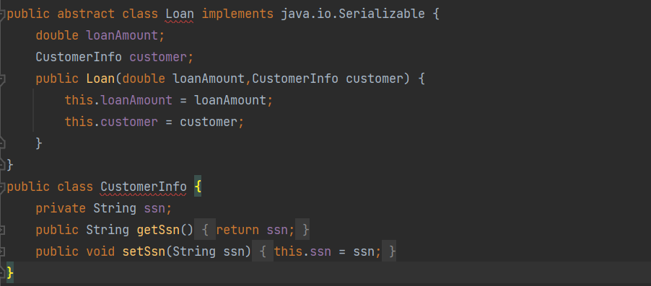
Aggregation
Aggregation represents the relationship where one object contains other objects.
It represents the weak relationship between objects.
It is also terms as a has-a relationship (while inheritance represents the is-a relationship)

Slide 14
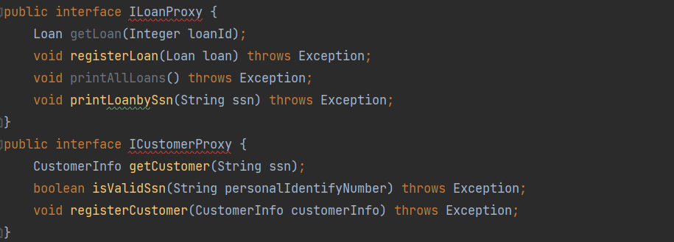
Low Coupling High Cohesive
Coupling refers to the level one class knows details / has dependency to another class.
Private, protected, public modifiers to display visibility level of a class
We can use interfaces for the weaker coupling since no concrete implementation is provided.
Cohesion refers to the level of a component which performs a single well-defined task.
High cohesive means a well-defined task is contained in a single package/unit.
Weak cohesive means a module might contain many unrelated tasks.
Below example shows low coupling high cohesive since Loan related tasks are located inside ILoanProxy interface while, customer related tasks are located inside ICustomerProxy.

Slide 15
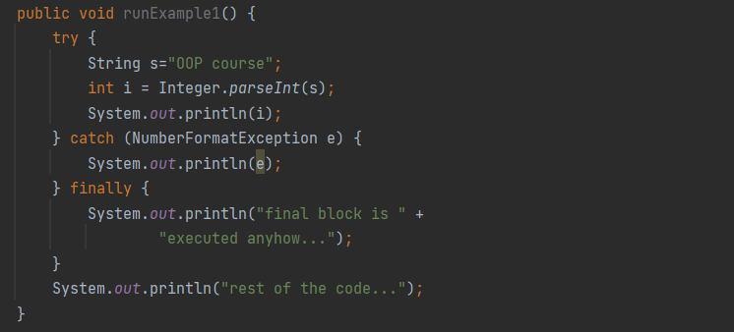
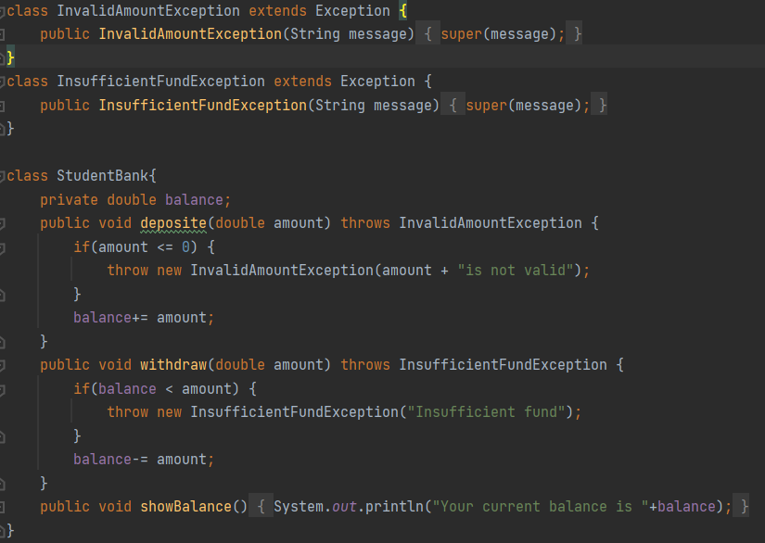
Exception handling
Types of Java exceptions
Checked Exception: exceptions that are checked at compile time
UnChecked Exception: exceptions that are checked at run time
Checked exceptions must be handled (try-catch) or specified by method signature (using throws)
Unchecked exceptions are not forced by compiler to either handle or specify.
Try-Catch-Finally block is used to handle exceptions.
We can specify our own customized exceptions, which extends from Exception class.
Throw & Throws: throw is used to throw an exception explicitly; throws is used in method signature to declare an exception might occur from inside the method.

Slide 16
ArrayList, HashSet, HashMap
Collection includes List and Set, where ArrayList is List, HashSet is Set.
ArrayList is a resizable array. You can access an element by using index.
It stores elements in order.
You can store duplicated elements.
HashSet is a collection of items. You can access items by iterative methods:
Use enhanced for loop
Use Iterable forEach loop
Use Iterator<T> interface
Different from Collection, HashMap uses (key, value) pair to store elements. You can access element by key.
HashSet does not allow duplicate values. HashMap allows duplicate values, while only unique keys.
Neither HashSet nor HashMap maintains order.

Slide 17
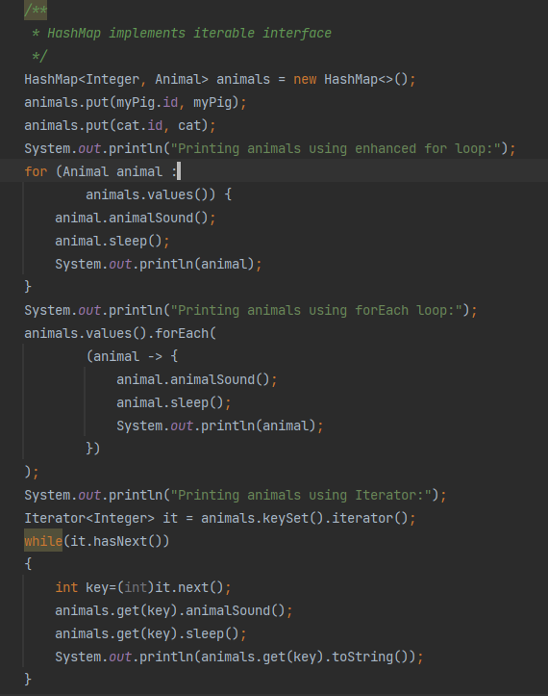
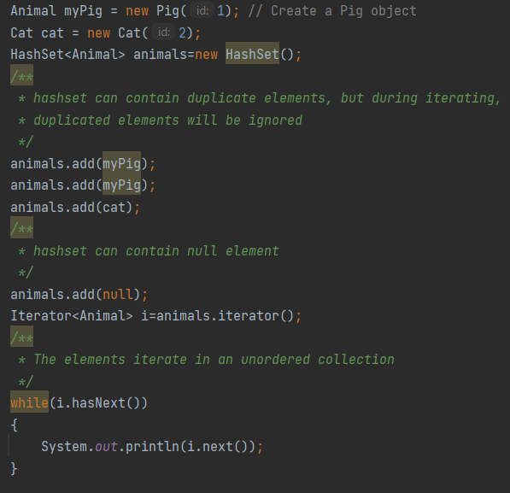
HashSet, HashMap
HashSet and HashMap

Slide 18
Today’s Main Goal
A Step-by-Step go through BankLoanSolution

Slide 19
A Step-by-Step go through BankLoanSolution
What OOP concepts have we used for BankLoanSoluton?
Encapsulation
Inheritance
Abstraction (abstract & Interface)
Polymorphism (overriding, overloading, upcast, downcast)
Aggregation
Low coupling high cohesion
We also used
HashSet, Lambda, etc…

Slide 20
Today’s Main Goal
Recipes for Clean Code

Slide 21
Recipes for Clean Code
Naming Convention
Meaningful names
Camel case for variable and functions, Nouns and Pascal case for class name
SNAKE UPPER CASE for constants
Low coupling, high cohesion
Avoid large functions
Single responsibility principle
Code reusability
Avoid deep nesting
Comments

